Slide 1
FAFSA and ORSAA
VOLUNTEER TRAINING

Slide 2
Agenda
1
Introductions
2
Before applying
3
What’s new on the Better FAFSA
4
Filling out the form
5
Next steps
Notes:
We hope that our time together provides you with all the information you’ll need. But remember – you don’t have to know it all! Financial aid forms can be complicated, and every student and family’s situation is different. There may be some students whose personal circumstances mean they have more complicated responses to the questions on the form. That’s what I’m here for! In fact, we’re particularly grateful for volunteers who can help with the more straightforward cases because it ensures we can devote more time to those who need more in-depth assistance. I’ll say it several times throughout this presentation because I really do mean it. If you don’t know the answer, that’s okay! That’s a great time to encourage the student or family to talk to me (and/or fill in the name/s of the people in your building who have the expertise to help with these situations).
Here’s what we will be talking about today:
Getting to know each other and why we think it’s important for all FAFSA/ORSAA volunteers to receive training this year, especially;
What students and families should have done before they see you and what you can do if they haven’t completed those steps;
What’s new or different from the last time you saw a FAFSA or ORSAA;
How to get started with the applications;
What the forms look like;
Some common questions students and families might have;
Final thoughts & reminders.

Slide 3
Introductions
(AND A POP QUIZ … OR TWO!)
Notes:
Let’s start by getting acquainted with who is in the room and the task we’re all coming together for.

Slide 4
When is the last time you filled out a financial aid application?
Think-Pair-Share
Notes:
First, take a moment to think about the answer to this question – when is the last time you filled out a financial aid form? Then, let’s do some quick introductions to learn who is in the room. Please share your name and the last time you filled out a financial aid application – either for yourself, your child or someone else.
I’ll start. Again, my name is __________. I’ve been helping students with their FAFSAs and ORSAAs for _____ years. The last time I did was _____________.

Slide 5
FAFSA Simplification Act
Passed by Congress in 2020
For students attending college in fall 2024+
Simplified Streamlined Redesigned
Notes:
It’s helpful that you’ve done this before.
But…
This year will be different! Back in 2020, Congress passed the FAFSA Simplification Act requiring changes to the FAFSA for students attending college in fall 2024 and beyond. We’re calling this Better FAFSA because it’s supposed to be better – simplified, streamlined and redesigned.

Slide 6
What does FAFSA stand for?
Finally Awarding Funds to Stellar Academics
Federal Application For Student Aid
Free Application for Federal Student Aid
Financial Aid For Students of America
Notes:
Before we discuss what you need to know about the changes and what you need to know to help students and families, how about a pop quiz?
Don’t worry – I’m not grading it. And it’s just two questions to make sure we all know what we’re here for!
FAFSA is an acronym. What does it stand for? Raise your hand when I read the response you think is correct.
Finally Awarding Funds to Stellar Academics
Federal Application For Student Aid
Free Application for Federal Student Aid
Financial Aid For Students of America

Slide 7
What does FAFSA stand for?
Finally Awarding Funds to Stellar Academics
Federal Application For Student Aid
Free Application for Federal Student Aid
Financial Aid For Students of America
Notes:
Nice! Yes, those of you who chose #3, Free Application for Federal Student Aid are correct.
It’s a pretty good name because it says exactly what it is.
It’s free – no student should ever pay to complete or submit it.
It’s the application that most students will complete.
And they need to do that to access federal aid like Pell grants, federal work-study and government-backed loans.
In Oregon, this application is also used to determine if students are eligible for state aid like the Oregon Opportunity Grant. Students applying for Oregon Promise and many other scholarships both in and out of state should also complete a financial aid form, usually the FAFSA.

Slide 8
What is the ORSAA?
Oregon’s Really Super Aid Application
Oregon Student Aid Application
Oregon’s Request for Some Alternative Aid
Other Reasons Students Ask for Aid
Notes:
On the last slide, I mentioned that “most students” complete the FAFSA. So what other financial aid application is out there? And who completes it?
What is the ORSAA? Again, raise your hand when I read the answer you think is correct.
Oregon’s Really Super Aid Application
Oregon Student Aid Application
Oregon’s Request for Some Alternative Aid
Other Reasons Students Ask for Aid

Slide 9
What is the ORSAA?
Oregon’s Really Super Aid Application
Oregon Student Aid Application
Oregon’s Request for Some Alternative Aid
Other Reasons Students Ask for Aid
Notes:
Those of you who said number 2, Oregon Student Aid Application got it!
Oregon students who are not eligible for federal financial aid should not complete the FAFSA. These students might still be eligible for state aid and so should complete the ORSAA.

Slide 10
What is the ORSAA?
https://oregonstudentaid.gov/fafsa-orsaa/fafsaorsaa-filter-tool/
Notes:
If a student doesn’t know which application to use, no problem! OSAC has a handy filter tool on their website. Ask the student or parent to answer the questions on that tool to determine which form they’ll need to complete.

Slide 11
Notes:
Because the ORSAA generally mirrors the FAFSA, it has also been redesigned for this year and beyond. Most, but not all, of what we’ll be talking about will be true for both forms. I’ve put a “FAFSA only” symbol in the upper right hand corner for those things that are true only for students completing the FAFSA.

Slide 12
Before filling out the form
Notes:
Our goal is that students and families arrive to the completion event ready to complete their applications. Let’s talk about what that means – and what you can do if they come without being as prepared as we’d like.

Slide 13
Email
Each person needs their own address
Personal, not school addresses
Professional addresses are best
Notes:
Both the students and the contributing parent will need to have their own individual email addresses.
Students should use one that is not their school email.
If you discover that one or both do not have an appropriate email address, your first step is to help them get set up with one.
Gmail is likely the easiest, but they can choose any option they’d like to – and that they will be able to easily check from their home or phone.
Please encourage students to choose an email address that can be used for professional purposes. FirstNameLastName is a good choice. SexyBaller121 is not.
You might have heard me use the term “contributing parent.” This is one of the changes for the Better FAFSA and the redesigned ORSAA. Make a note of it – we’ll come back to it later.

Slide 14
FSA ID
Each person needs their own FSA ID
Parents who have one from an older child don’t need a new one
Notes:
Another thing that both the student and contributing parent each need to have is an FSA ID. Again, these will be unique for each family member. Parents who have older children who are in college probably already have an FSA ID, and they can and should use it.
If either the student or contributing parent don’t have an FSA ID, they’ll need to get one before they can complete the FAFSA.

Slide 15
While waiting for an FSA ID
Oregon Promise
OSAC Scholarship
Other scholarships
Notes:
Getting the FSA ID may not be automatic. It can take a few days for the process to happen, so it’s possible that this will be the final FAFSA-related step a family can do in this session.
If that’s the case, and the student or family is anxious to do more, you can offer other options that will help them pay for college. For example, encourage the student to complete their Oregon Promise application if they plan to attend an Oregon community college. They could start the OSAC scholarship application. Or they can search for other scholarship opportunities using Oregon Goes To College’s scholarship calendar.

Slide 16
Better FAFSA*
WHAT ARE THE CHANGES?
*and ORSAA
Notes:
Before we get to the nuts-and-bolts of filling out the form, let’s talk about some of the key changes. If you’ve ever filled out a FAFSA or ORSAA before, either for yourself, your child or another student, this new “Better FAFSA” will look different and should take less time. If you’ve never filled out a FAFSA or ORSAA before, this next section should still help set the stage for what you need to know to help students.
There are several changes, but let’s talk about the most significant ones.

Slide 17
Old Form
Better FAFSA
Shorter form:
As few as 18 questions to answer
Notes:
The form is significantly shorter.
Last year’s FAFSA had 103 possible questions to answer.
The Better FAFSA, can only be completed online, and it will use skip logic to direct students and parents to the questions they need to answer.
Applicants will be able to skip as many as 26 questions, depending on their individual circumstances. Some applicants will have to answer as few as 18 questions on the form.

Slide 18
Old Form
Better FAFSA
Don’t connect to IRS?
Everyone connects to the IRS database
Connect to IRS?
Notes:
In the recent past, applicants could choose to use the IRS Data Retrieval Tool to reduce the paperwork burden by having their tax information automatically uploaded. For families that could choose this option, it often made the form easier, but not everyone could –or wanted to- use the tool.
On the Better FAFSA, there is no choice. All applications will be connected to the IRS’s database through the IRS Direct Data Exchange. The good news is this means families don’t need to have their tax information with them to complete the forms. It should also reduce the number of errors, which will make the process go faster for everyone.

Slide 19
Old Form
Better FAFSA
Old vocabulary, like:
Expected Family Contribution (EFC)
Student Aid Report
“Room and Board”
New Vocabulary
Notes:
There are some vocabulary changes. For example,
EFC, or expected family contribution, is gone. Instead, the new calculation of a family’s ability to contribute will be called the Student Aid Index
Students will not receive a Student Aid Report, or SAR, after they complete the FAFSA. Instead, they will get a FAFSA Summary Submission
Some language changes are in keeping with the times – “room and board” and “unusual or special circumstances” are out. “Food and housing” and “personal circumstances” are in.

Slide 20
Old Form
Better FAFSA
Financial aid parent was the one the student lived with more than 50% of the year.
Notes:
Another major vocabulary change is related to parents. Instead of having a “Financial Aid Parent,” the new preferred term is “contributor.”
There is also a key change in which parent’s is the contributor, and therefore is the one required to complete the application. In the past, the FAFSA Parent was the one who the student lived with more.
Note this BIG CHANGE: the contributing parent is the one who contributes the most financially. This is the parent who needs to complete the application.

Slide 21
Old Form
Better FAFSA
12 most common languages
Notes:
The form was previously available in English and Spanish.
The Better FAFSA, as well as resources and translation services, is now available in the 11 most common languages spoken in the US by English language learners. Please encourage students and families to use the form that is most comfortable for them – even if it isn’t necessarily the most comfortable for you.
The ORSAA will continue to be available in only English and Spanish.

Slide 22
Old Form
Better FAFSA
More colleges
Notes:
In the past, students could list up to 10 colleges or universities on their application. These are the colleges the student has applied to or plans to apply to. Listing a college allows them to access the student aid index and other information in order to prepare a financial aid offer.
With the Better FAFSA, students can now list up to 20 colleges or universities. Since the pandemic, the research tells us that students should have at least one local option on their list.
Therefore, we recommend that all students include their local community college in this list, even if they think they’ll only apply to 4 year colleges and universities. Please encourage them to do so.

Slide 23
Filling out the form
Notes:
Okay! Now let’s get to the nuts-and-bolts of helping students and parents complete the form.

Slide 24
You are not alone
Notes:
First and foremost, remember – you are here to help, but you do not have to be the expert! We are all in this together, and I certainly don’t expect you to have all the answers. If you don’t know the answer, please don’t guess – ask! The people in our school/organization who have more training and can help find answers are __________________________.

Slide 25
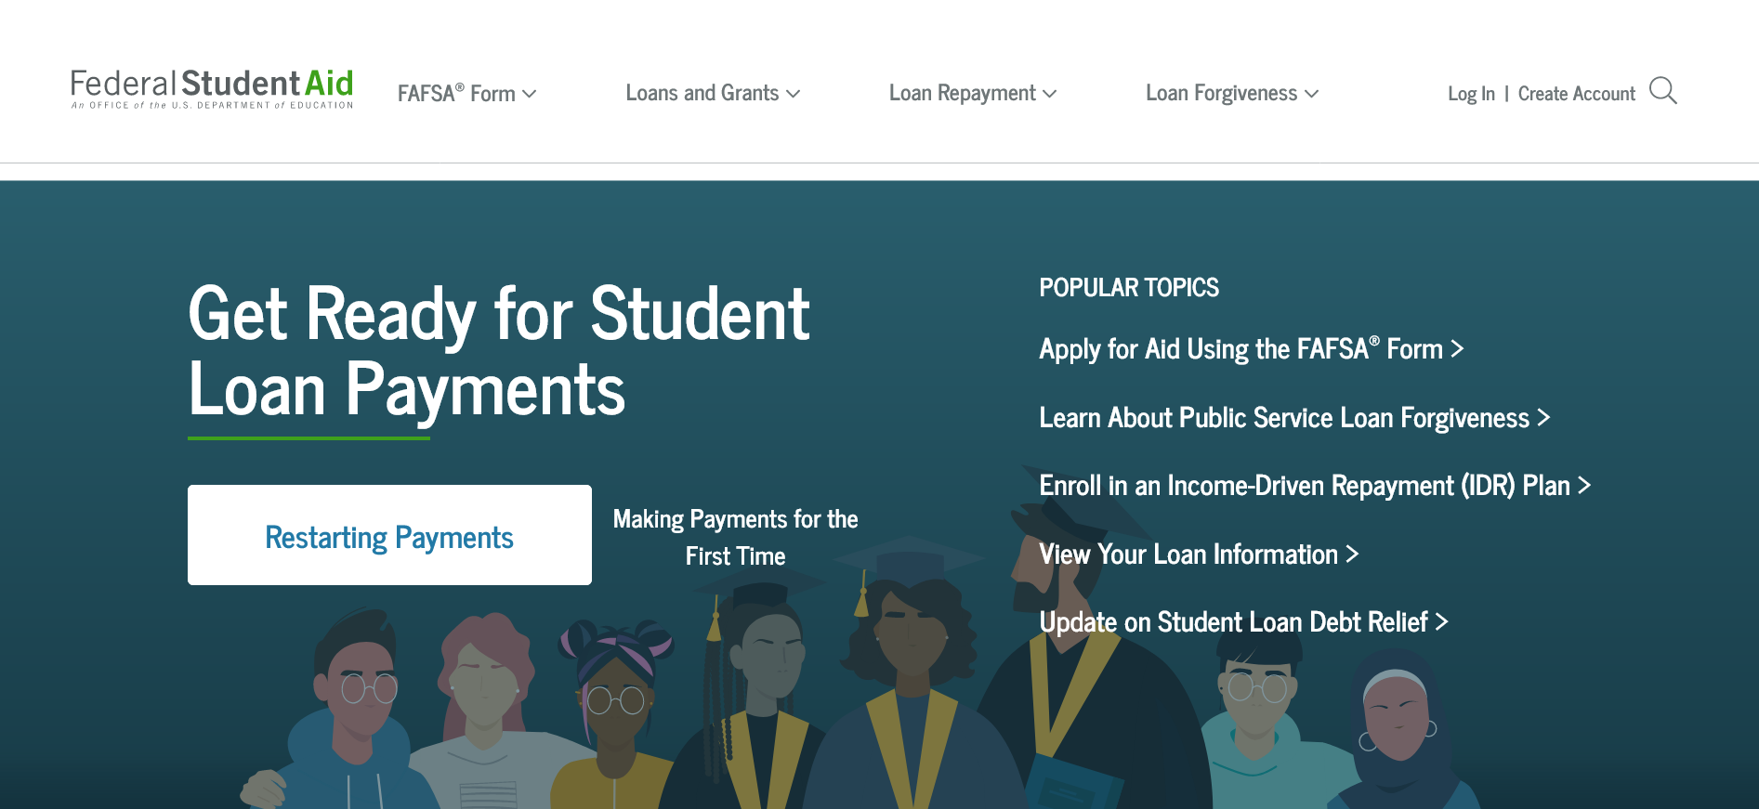
Where do I log in?
https://studentaid.gov/
Notes:
Once everyone has their email addresses and FSA ID, it’s time to log in.
For the FAFSA, go to the Federal Student Aid website and choose “Complete the FAFSA Form” from the drop-down “FAFSA Form menu.”

Slide 26
Where do I log in?
https://oregonstudentaid.gov
Notes:
For ORSAA, start on the Oregon Student Aid website and choose “FAFSA?ORSAA Filter Tool” from the “FAFSA/ORSAA” drop-down menu. This will take them through a series of questions that confirms which application they should complete. If it is determined they should complete the ORSAA, a button to start the form will appear.

Slide 27
Key Reminders
1
You are not alone!
2
You do not have to know all the answers.
3
If you’re stumped, check in with school staff.
Find more information at OregonGoesToCollege.org or studentaid.gov
4
Notes:
(Note to presenter: change “school staff” above to the name of the person you want volunteers to reach out to with questions)
The most important thing I hope you take away from our time together is that you are not alone and you do not have to know all the answers. When a student or parent has a situation that isn’t straightforward, please check in with me (or the person in the school you want them to go to). We value your time and effort in helping all students, and the more volunteers who can help, the more time we have to assist families who have personal circumstances that may require additional support.

Slide 28
Questions?

